Slide 1



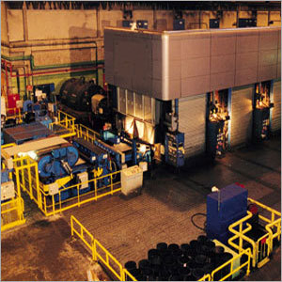
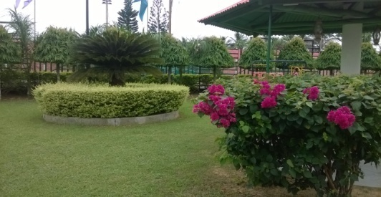

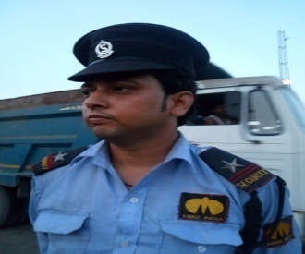
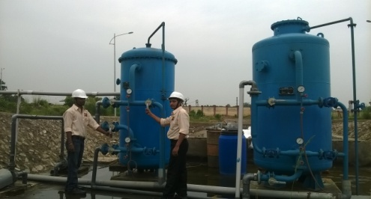
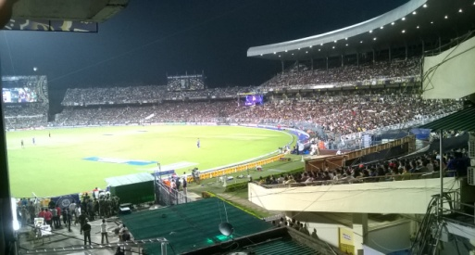
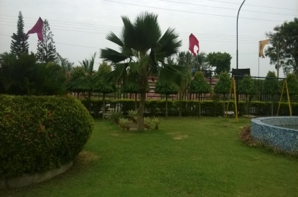
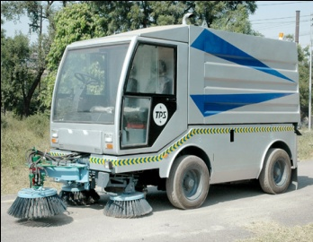

An ISO 9001 : 2008 Certified Company
A TRUSTED SERVICE PROVIDER IN INDIA
TOTAL FACILITY MANAGEMENT SERVICE
UNDER ONE ROOF
“SAFETY & SECURITY” IS A ESSENCIAL PART IN OUR ALL ACTIVITIES

Slide 2
OUR FIELD OF OPERATIONS
● FACILITY MANAGEMENT SERVICE ● HOUSE KEEPING SERVICE ● CLEANING SERVICE ● ROAD SWEEPING ● INDUSTRIAL HOUSEKEEPING ● SECURITY GUARD & SURVILLIANCE SERVICE ● OPERATION & MAINTENANCE OF RIDE ON SWEEPING MACHINE,STP,WTP,DM PLANT ETC ● CONVEYOR BELT MAINTENANCE ● LADLE CLEANING SERVICE ● HORTICULTURE ( LANDSCAPING, GARDEN BEAUTIFICATION & MAINTENANCE) ● PEST CONTROL SERVICE ● EVENT MANAGEMENT SERVICE ●BMS ● TABLE TOP PROTOTYPE MODEL CREATIONS OF PROJECTS ● COMPLETE HR SOLUTION ( HUMAN RESOURCE ) ● OTHER RELATED SERVICE ●

Slide 3
TYPE OF CUSTOMERS, TO WHOM WE OFFER OUR SERVICE
→ CORPORATE HOUSES & BANKS,
→ HOTELS, GUEST HOUSES & RESORTS,
→ INSTITUTES ( SCHOOLS , COLLEGES & OTHERS )
→ OFFICES , FOCTORIES & COMMECIAL AREA
→ UNDER CONSTRUCTION PROJECT AREA
→ SHOPPING MALLS & MARKET COMPLEX
→ MULTISTORIED RESIDENTIAL & COMMERCIAL COMPLEX,
→ HOSPITALS & NURSING HOMES,
→ FILM & TV STUDIOS
→ INDIVIDUALS ( FOR EVENT SERVICE ONLY )

Slide 4
AREA OF OPERATIONS
PRESENTLY WE ARE WORKING IN
→ EASTERN ZONE ( MAINLY WEST BENGAL , BIHAR , ORISSA , ASSAM & OTHERS ).
EASTERN ZONE CONTACT: ( KOLKATA )
B. CHAKRABORTY – 09903498924/9007878854
→ WEASTERN ZONE ( ALL )
WEASTERN ZONE CONTACT :
B.K.CHAKRABORTY - 09920023154 ( MUMBAI)

Slide 5
Company Profile:
We are one of the eminent Facility Management Service providers in Kolkata. We hold expertise in offering a wide range of services, which includes House Keeping, Cleaning, Security Service, Garden Beautification, Annual Maintenance, Event Management, and Facility Management. These Facility Management Services are widely acclaimed among our clients for the features like efficient functioning, reliable operations, and perfect performance. Owing to varied quality characteristics, our services are ideally applicable for various Corporate, Hospitals, Institutes, and Hotels. We are striving to provide customized services to the clients for meeting their varied needs.

Slide 6
Company Profile:
All the services integrate all systems and controls at the client facility into one manageable area. We assure our clients with world-class facility management services due to state of the art infrastructure. We have appointed a team of efficient professionals, who have rich experience and profound knowledge of the industry. All the professionals work in close coordination to ensure maximum satisfaction of the clients. Our endeavor is to provide the best service in all the branches of operation in a very professional and economical manner. Our team of quality controllers keeps their vigil eye over entire services for meeting the desired needs of the clients with efficient manner. We are a client oriented organization, which believe in offering world-class facility management at the affordable rates.

Slide 7
SERVICE PORTFOLIO
We are one of the prominent service providers of Facility Management Services, which are widely known for various quality features like efficient functioning, optimum performance, and perfect operations.
Some of the services offered by us are as follows:
Facility Management Service :
A. Security & Surveillance Support ,
B. Security Guard ( Civilian , Armed, Ex-Serviceman ) Service in all respect.
C. Housekeeping : Manual & Mechanized .
D. Technical Maintenance Support ( Operation & Maintenance): Electrical Service & Mechanical Service,
E. Garden Maintenance Service: Landscaping, Development , Cleaning , Beautification & AMC of Garden.
F. Pest Control : Pest Control Service .
Cleaning Service: Facade cleaning, Glass Cleaning, Carpet Cleaning , Sofa Cleaning, Curtain Cleaning, Blanket Cleaning , Swimming Pool Cleaning, Ladle Cleaning Service, Dross Handling Service, Factory Cleaning Service, Residential Cleaning Service ( Periodical ) , Toilet Cleaning Service , Floor Cleaning Service, Wall Cleaning Service , Cobweb Cleaning Service for Commercial, Water Body Cleaning Service, Waste Disposal Management Service.

Slide 8
SERVICE PORTFOLIO
Road Sweeping Service : Road Sweeping ( Manual & Mechanized ), Operation & Maintenance of Road Sweeping Machine.
Operation & Maintenance Support :
A. O & M of Road Sweeping Machine ,
B. O&M Sewerage Treatment Plant ( STP ) ,
C. O &M Water Treatment Plant ( WTP ) ,
D. O&M Reverse Osmosis Plant ( R.O Plant ) ,
E. Operation & Maintenance of D. M. Plant,
F. O & M of Security Surveillance Support ,
G. Maintenance of Conveyor Belt.
Fire & Safety : We undertake the repair, O&M of Sprinkler & Hydrant system of fire unit, refilling of fire extinguisher.
Event Management: Complete organizer of Party, Hindu Marriage, Seminars & Other Festivals

Slide 9
SERVICE PORTFOLIO
• Garden Beautification & Maintenance: Garden Development , Beautification & Maintenance by application of quality fertilizers, insecticides, germicides & hormones .
•Pest Control Service : Pest Control done by experienced and efficient workers by modern machines & new techniques under supervision of experienced supervisor.
• Human Resource :Complete solution HR Management for Corporate, Hotels, Industries & Institutes , Man power Supply.
• Project Service :Project Consultancy, Operation & Maintenance
• Table Top Prototype Model : Table Top Prototype Model Creator of Different type of Projects .Our Team An efficient team of professionals is utmost requirement for every organization.
Training Programs : We have appointed a team of experienced professionals, who have rich experience and sound knowledge of the respective domain. These professionals are ready to take the challenging environment of 24*7 working environment. We also conduct regular training sessions of our employees for enhancing their skills.

Slide 10
-:Company at a Glance:-
NAME OF THE COMPANY : MBIZ INDIA
CITY OFFICE ADDRESS : BAGUIHATI MARKET COMPLEX ,
NARAYANTALA LANE, NARAYANTALA
WEST , NEAR VIP ROAD , BAGUIHATI ,
KOLKATA – 700059 , WEST BENGAL , INDIA.
REGD. ADDRESS : 148/2, JOGIPARA ROAD, DUM DUM,
KOLKATA – 700028 , WEST BENGAL, INDIA.
E. MAIL I.D :mbizindia00@gmail.com / info@mbizindia.in
WEBSITE : www.mbizindia.in
TYPE OF OWNERSHIP : PROPRIETORSHIP.
NAME OF THE : MRS. MITHU CHAKRABORTY
PROPRIETOR
▪ TELEPHONE NO. : +91-33-25760435
▪ MOBILES(EAST REGION) : +919903498924/9007878854
▪ MOBILES(WEST REGION) : +919920023154.

Slide 11
-:Certificates / Registrations at a Glance:-
PAN NO. : AJQPC2500E
TRADE LICENSE NO. : B-3641 & B-3642
SERVICE TAX NO. : AJQPC2500ESD001
EPF NO. : WB / CA / 60764
ESIC NO. : 40000424880001019
ISO CERTIFICATE NO : 1015QCM12
LIN No. (Issued by
Ministry of Labour &
Employment., Govt.
of India . ) : 1-6300-5880-5
● Trade Mark No. : 3078909
● MSME UAN No. : WB14D0002353
● Aadhar No : 917409027239

Slide 12
Facility Management Service
We are one of the eminent & Trusted Service Provider of Facility Management Services for our esteemed clients. We have an efficient team of professionals, who are experts in giving complete solutions of all kinds of services included in facility management in alignment with current trends and components as per specific needs of clients. We make use of professional methods for completing every project to make our service reliable and flexible.

Slide 13
Facility Management Service
We serve Total Facility Management in different sectors like ,
● Corporate Houses ● Shopping Malls
● Hospitals & Nursing Homes
● Schools & Colleges ● Institutions
● Guest Houses
● High Rise Corporate Complex
● Residential & Commercial Complex
● Railways ● Factories ● Offices
● Hotels ● and many others.

Slide 14
In our wide range of facility management comprises:
OFFERED SERVICES AT A GLANCE
Security Guard Service & Surveillance, Housekeeping & Cleaning , Waste Disposal Management Service, Facade Cleaning Service, Swimming Pool Cleaning & Maintenance & Operation, Road Sweeping (Mechanized & Manual), Ladle Cleaning Service, Dross Handling Service, Operation & Maintenance of STP, WTP, RO Plant, Conveyor Belt , O&M of Fire & Protection System, Pest Control, In house Electrical & Plumbing Maintenance ,Human Resource (Manpower Supply ) , Telephone & Net working, Lift Operation & Maintenance, Garden Beautification & Maintenance ( Horticulture ), BMS Service, & Others as desired by the Customer.

Slide 15

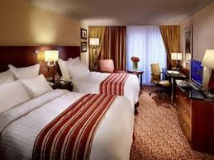
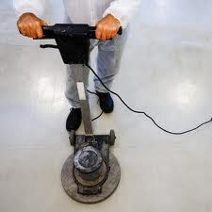

-:House Keeping & Cleaning:–
We are specialized in offering Annual Housekeeping & Cleaning Maintenance Services to our esteemed clients. Our House Keeping & Cleaning Services are appreciated among our clients for the attributes like efficient functioning and reliable operations. Our efficient Housekeeping Staff are experienced in both Manual & Mechanized process. These premium housekeeping services are ideally applicable for various corporate office, medical institutes, and hospitals. We are committed to provide customized housekeeping and cleaning services as per desired needs of the clients.

Slide 16
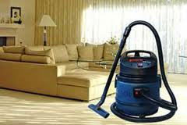

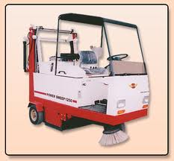
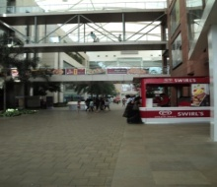

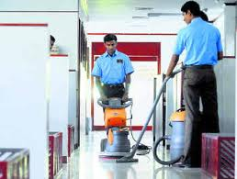
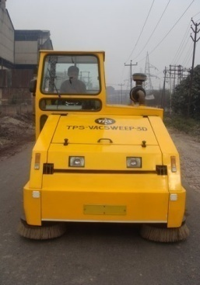
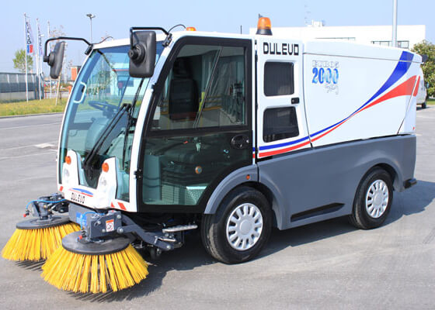

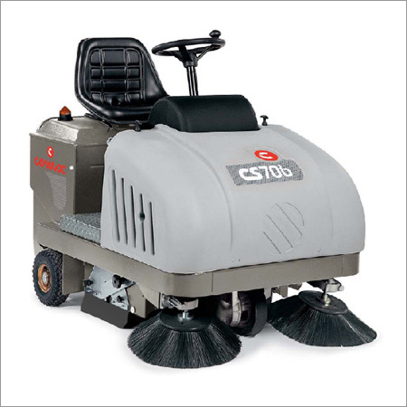
CLEANLINESS IS CLOSE TO GODLINESS , BE CLEAN , BE SMART , USE SAFETY.
Our efficient Housekeeping Staff are experienced in both Manual & Mechanized process. The total work process is done Scientifically & Methodically to save energy and as well as Time & Material. Different types of machines are adopted for different types Interior & Exterior jobs.
ROAD SWEEPING MACHINES

Slide 17
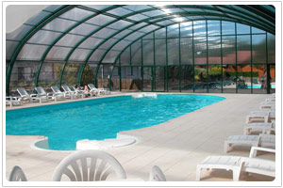
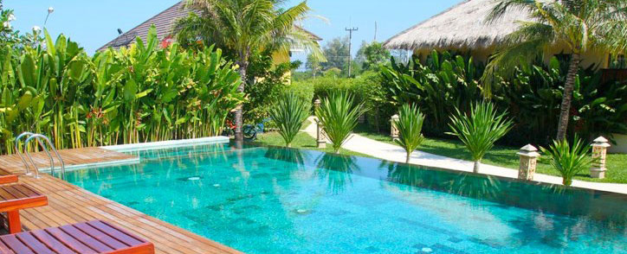
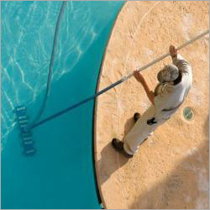
-: Periodical cleaning & AMC :-
Special Periodical cleaning is done as follows –
Swimming Pool Cleaning & AMC .
Now a days, in most of the Building complexes, the peoples are using pools. Now its not a passion , it is for health exercise and for relaxation. But in most cases , the pools are not maintained by proper hygenic way as a result for which peoples are suffering for skin diseases and many others.
We always try to clean the pools by application of proper hygenic materials by experienced technicians .

Slide 18
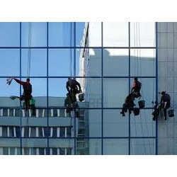
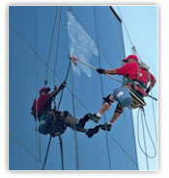
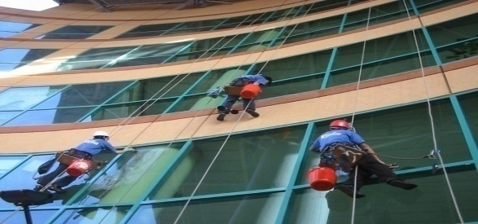
Special Periodical cleaning is done as follows –
2. Sofa Cleaning Service in corporate and in domestic by using modern chemicals and within a very short period .
3. Chair Cleaning Service in corporate and in domestic by using modern chemicals and within a very short period .
4. Carpet Cleaning service by using mechanized foam technology and within a very short period.
5. Periodical cleaning of entire house, upholsteries, curtains and all others at very competitive price.
6. Facade Cleaning by experienced workers ( manual & Mechanised ) by using modern rapid cleaning materials.
We also install Façade Cleaning Machineries to High Rise Buildings

Slide 19
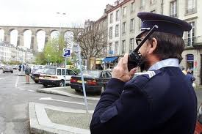

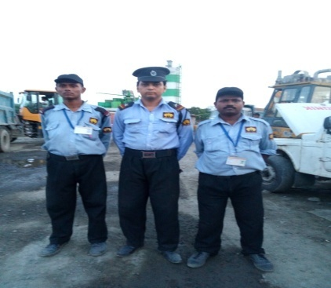
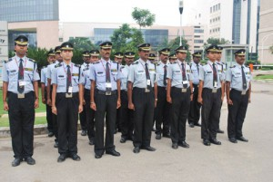
BE SAFE & PROTECTED BY A PROFESSIONAL SERVICE PROVIDER
Provider of Security Officer, Guard, Supervisor & Fireman
-: Security Guard & Surveillance Service Support :-
We are acclaimed among our clients for offering Security Service, which are
basically engaged in our company as per their educational qualification,
intelligence , physical structure, previous records and present health.
We depute desired male or female security officer, executives, supervisors,
fireman & security guards in every sector as mentioned above at very
reasonable cost. We have employed a team of experienced professionals
with rich experience and profound knowledge of security industry to
conform to the international quality standards.
A Training session is done by an ex serviceman to each security personal before joining in their jobs.

Slide 20

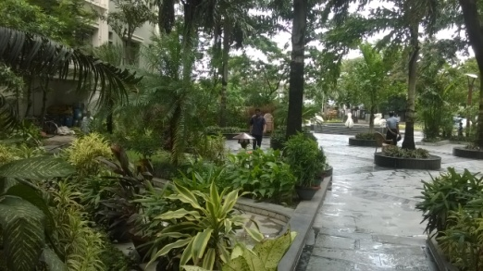
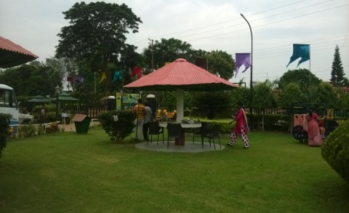
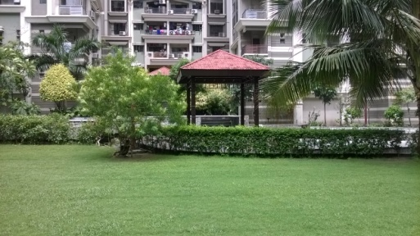
Garden Beautification & Maintenance Service
-: HORTICULTURE SERVICE :-
We undertake complete responsibilities of Landscaping , Manual & 3D Design, Grass Carpeting, Plantation of Ornamental Trees & Flowers for Elevated , Non Elevated & Roof Top Gardens.
Annual Maintenance & Beautification of Garden (Interior , Exterior & Rooftop ) is done by applying good quality fertilizers , insecticides , germicides, Hormones etc. and by our Technically experienced Staff.
We also undertake Ponds water treatment considering the usual habitants by application of Electro Mechanical Device and quality aqua treatment chemicals.

Slide 21

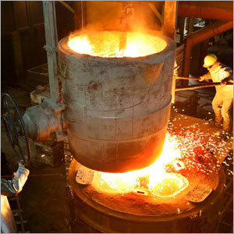
Reputed Turnkey Contractors OF The Following
Project Execution - EPC format
Operations & Maintenance
Material Handling
Other Industrial Services

Slide 22
Core Values
Vision
To be the Leader in Turnkey Projects Execution and Industrial O&M Services in the Country.
Mission
To deliver the highest levels of satisfaction to our Clients in terms of Quality, Safety, Reliability and Cost Effectiveness of Projects and Services

Slide 23
Area of Work
( Operation & Maintenance )
Industrial Structures
Erection & Commissioning
Piping & Fabrication
Installation of Machinery & Equipments
Mechanical & Electrical Works
Complete Plant Dismantling/Installation
O&M, AMC’s of all the above work done

Slide 24
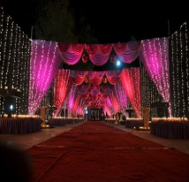
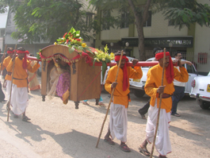
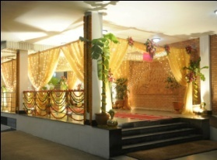
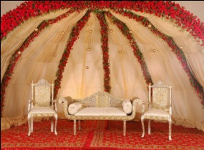
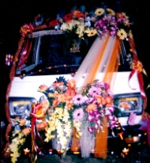

-:EVENT MANAGEMENT:-
Wedding Planer / Organiser
We undertake turn-key contract with full responsibility to organize all types of events (Planning to Execution ) like Hindu Marriage, Seminars, Party & Other functions. The total function includes –
A to Z arrangement and implementation of Hindu marriage formalities, arrangement of Luxury Cars, Palanquin ,Decoration of pandel , dias & wedding bed with or without flower , all decorator items , Photography ( Still & Video ), Lighting, Generator, Music System , Caterer , Live Concert , Sahanai, Band Party , Horse pulled Carts , DJ and many more as customers desires.
We always take care to offer our best services, best quality of material and hospitality to our valued customers to ensure their satisfaction without anxiety.

Slide 25
COMPLETE HR SOLUTION
-: Human Resource / Manpower Supply :-
OUR PLACEMENT DIVISION HAS ABILITY ARRANGE DIFFERENT
TYPES OF CANDIDATES ACCORDING TO THE REQUIREMENT OF
OUR VALUED CUSTOMERS. A LARGE NUMBER OF CANDIDATES
HAD ALREADY BEEN PLACED BY US IN DIFFERENT SMALL,
MEDIUM & LARGE SCALE COMPANIES. WE CAN ARRANGE THE
FOLLOWING CANDIDATES,
TECHNICAL & NON TECHNICAL CANDIDATES.
GRADUATE & DIPLOMA ENGINEERS( MECHANICAL, ELECTRICAL,CIVIL, ELECTRONICS, B.TECH ETC.).
MBA IN DIFFERENT STREAMS.
INHOUSE AND SITE SUPERVISORS.
PROFESSIONALS OF DIFFERENT STREAM.

Slide 26
-: Human Resource :-
FRONT OFFICE & BACK OFFICE EXECUTIVES OFFICE ASSISTANTS.
TELEPHONE OPERATORS.
RECEPTIONIST ( MALE & FEMALE ).
ACCOUNTANTS.
SALES & MARKETING EXECUTIVES.
COUNTER SALES BOYS & GIRLS.
COOKS FOR HOTELS, GUEST HOUSE & OFFICE CANTEENS.
F&B EXECUTIVES.
SKILLED & UNSKILLED WORKERS ETC.

Slide 27
-: Human Resource :-
ALL CANDIDATES WILL BE FRESH OR EXPERIENCED. THEY ARE PLACED ACCORDING TO OUR CUSTOMERS REQUIREMENT AND ACCORDING TO THEIR QUALIFICATION, EXPERIENCE AND SCORE OF FINAL INTERVIEW TAKEN BY THE HR OF OUR VALUED CUSTOMER . WE CAN ARRANGE DIFFERENT TYPES OF CANDIDATES FOR ANY OTHER JOBS.
REQUIRED TIME FOR ARRANGEMENT OF CANDIDATES = 10 DAYS.

Slide 28
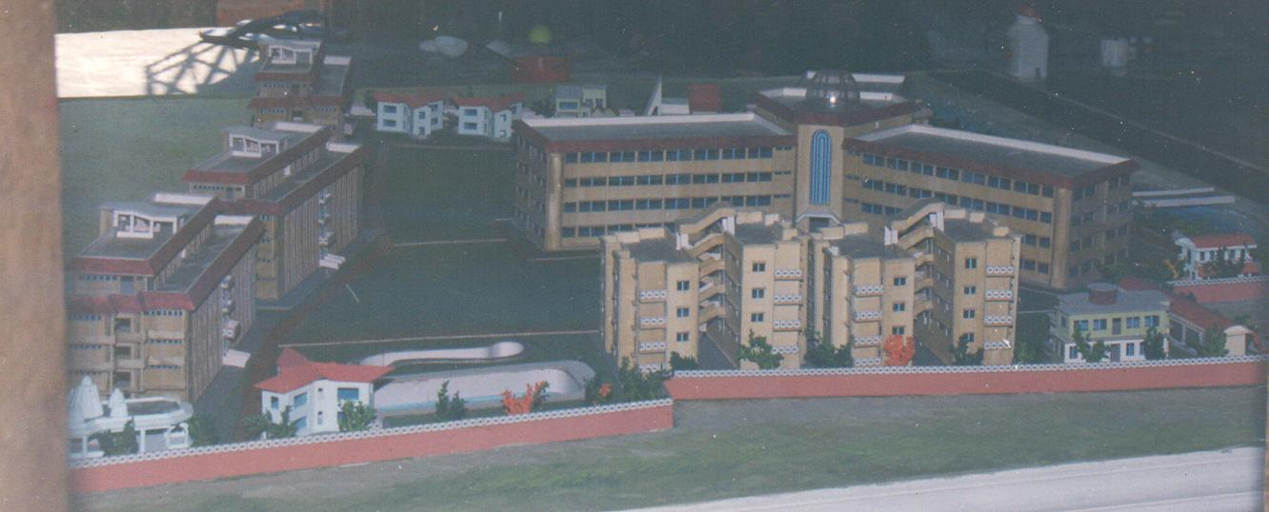
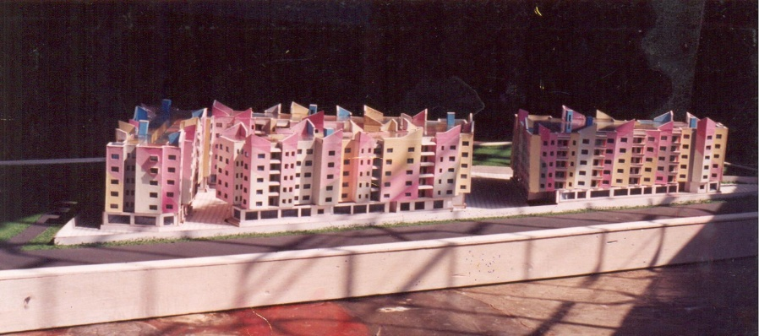
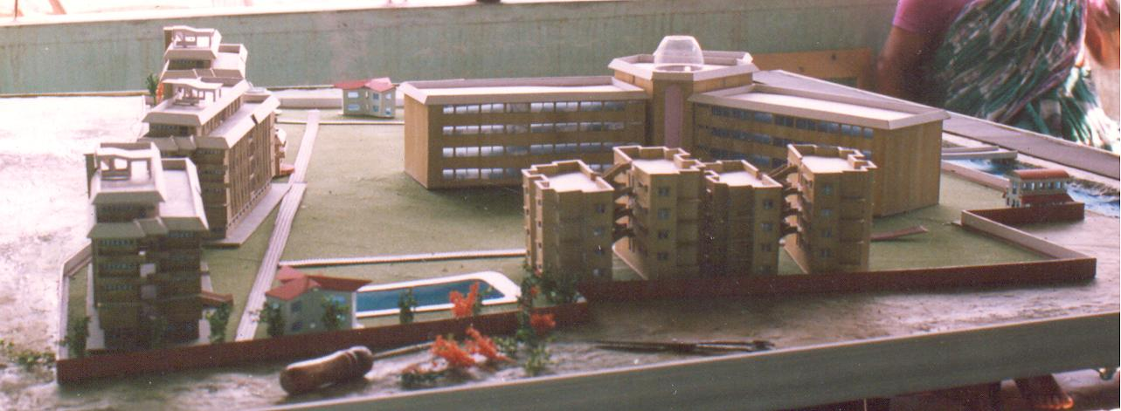
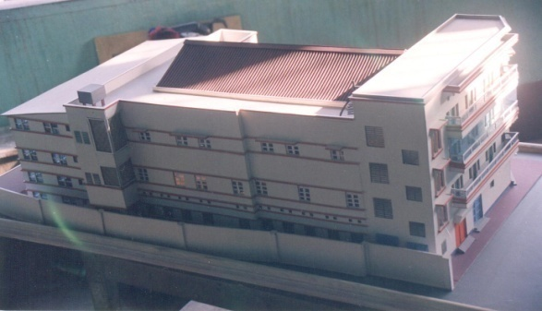
Prototype Model Creation
( Photographs of few designs & Models )
WE ARE ONE OF THE EMINENT CREATOR OF PROTOTYPE MODELS OF DIFFERENT PROJECTS. A GROUP OF EFFICIENT ARTISTS ARE IN OUR ACCOUNT . THEY CREATE THE MODELS ACCORDING TO THE DESIGNS , LAY-OUT , 3D DESIGNS & PHOTOGRAPHS SUPPLIED BY THE CUSTOMERS . WE HAVE BEEN APPRECIATED BY DIFFERENT CLIENTS FOR ACCURACY , CREATIVITY , OF OUR MODELS .

Slide 29
ORGANISATIONAL STRUCTURE
ADVISORY BOARD OF MBIZ INDIA
↓
CHIEF EXECUTIVE OFFICER
↓
CHIEF OPERATION MANAGER
_________________________________↓_______________________________
↓ ↓ ↓ ↓ ACCOUNTS OFFICER MANAGER FACILITY EVENT
↓ ( MARKETING ) MANAGER MANAGER
OFFICE & ACCOUNTS ↓ │ ↓
( MKTG DIV ) │ OPERATORS
____ ↓ ____________________
↓ ↓
MANAGER MANAGER
( HOUSEKEEPING ) ( SECURITY SERVICE )
________↓_______ ______↓______
↓ ↓ ↓ ↓
SITES SITES SITES SITES

Slide 30
ORGANISATIONAL STRUCTURE
THE STRUCTURE MAY CHANGE DEPENDING ON THE SITUATION , EVIRONMENT AND PLACE OF WORK .
COMMENCEMENT OF WORK :
THE WORK WILL COMMENCE WITHIN 15 DAYS FROM THE DATE OF RECEIPT OF W.O / L.O.I FROM THE CUSTOMER.

Slide 31
Safety Compliance
Zero Accident Safety Approach without Adverse Effect on Health & Environment
Safety PPE’s Provided by MBIZ INDIA
On Job Safety Training for New Employees
Class Room Safety Trainings at regular intervals
● Safety Mask ● Helmet ●Safety Goggles
● Ear Plug ● Rubber Hand Gloves ●Apron
● Safety Jacket ●Leather Hand Gloves ●Safety Shoes
● Safety Belt ● Fall Arrester & Fall Arrester Rope
● Descender & Descender Rope ● Full Body & Half Body
Harness.
The use and utility of above PPE will depend on the nature of job and practical situation of the present site .

Slide 32
EHS ( Environment Health & Safety ) Policy Of MBIZ INDIA
To provide appropriate training and disseminate information to enable all employees to accept individual responsibility for Environment, Health and Safety, implement best practices, and work in partnership to create a culture of continuous improvement.
To take account of environment, occupational health and safety in planning and decision-making.
To contribute to sustainable development through the establishment and implementation of environment standards that are scientifically tested and meet the requirement of relevant laws, regulations and codes of practice.
To instill a sense of duty in every employee towards personal safety, as well as that of others who may be affected by the employee's actions.
To provide and maintain facilities, equipment, operations and working conditions which are safe for employees, visitors and contractors at the Company's premises.
To ensure safe handling, storage, use and disposal of all substances and materials that are classified as hazardous to health and environment.
To reduce waste, conserve energy, and promote recycling of materials wherever possible.
To institute and implement a system of regular EHS audit in order to assure compliance with laid down policy, benchmarked standards, and requirements of laws, regulations and applicable codes of practice.
To proactively share information with business partners towards inculcating world-class EHS standards across the value chain of which MBIZ INDIA is a part.

Slide 33
Quality Policy of MBIZ INDIA
Health safety and environment policy is spelled out as under. Give priority to health, safety and protection of environment when carrying out its activities and we get it implemented on our Workers when work is in progress.
Train its personnel in health safety and protection of environment before and during all types of field activities. Insist on personnel protective equipment ( PPE ) being worn systematically.
Develop an association with the authorities and develop and adopt the emergency and evacuation procedures to minimize the consequences of accident Research and establish procedures which improve, health, safety and environment protection and have sites check actively and regularly by management and HSE department.
Give priority to health, safety and protection of environment when carrying out its activities and we get it implemented on our Workers when work is in progress.
Define practical means for taking into account and minimizing the impact of our activity on the environment. No smoking in camps. Incorporate these principles into responsibilities of its management. By applying these principles we aim to improve our working conditions and ensure quality services for our clients.

Slide 34
ADVISORY BOARD OF MBIZ INDIA
1. MR. ARUN CHAKRABORTY
EX- MANAGER OF NICHOLAS PIRAMAL INDIA LTD.
EXPERIENCE – 40 YEARS IN MARKETING & HOSPITALITY.
2. MR. B. K. CHAKRABORTY
B.E .( MECHANICAL ) , SUGER TECH. , INDUSTRIAL TRANNING FROM GERMANY.
C.E.O. OF VAMAN ENGINEERS INDIA LTD. , MUMBAI.
EX GENERAL MANAGER OF UNION CARBIDE OF INDIA LTD.
EX. GENERAL MANAGER OF GUJRAT HEAVY CHEMICALS LTD. & OTHERS.
EXPERIENCE : ERECTION & COMMISSIONING OF PROJECTS,
FACTORY MAINTENANCE , MODERNISATION OF PLANTS & INDUSTRY, OPERATION & MAINTENANCE, FACILITY SERVICES, HOSPITALITY & HOUSEKEEPING SERVICES ETC. TOTAL EXPERIENCE 38 YEARS.

Slide 35
ADVISORY BOARD OF MBIZ INDIA
3. MR. S. K . CHAKRABORTY
EX GENERAL MANAGER OF LARSEN & TOUBRO LTD. , ECC DIV. , NEW DELHI.
EX - Vice President, Fedders Lloyd Corporation Limited
B.E ( ELECTRICAL ) , A.M.I.E ,
EXPERIENCE : ERECTION & COMMISSIONING OF PROJECTS
( INDIA & OVERSEAS ).
INDUSTRIAL MANAGEMENT , MODERNISATION OF PLANTS ETC.
4. MR. KAMAL BHATTACHARYA
ONE OF THE OWNERS OF
SAMSONS ( INDIA ) , STARKMAN GESHAFTE .
MANUFACTURER OF MECHANICAL & ELECTRICAL CARBON
AND TEFLON SPHERES.
EXPERIENCE : 50 YEARS .

Slide 36
ADVISORY BOARD OF MBIZ INDIA
5. Mr. B. CHAKRABORTY
D.T.Q.M. ISO 9001
EXPERIENCE : 24 YEARS.
ERECTION COMMISSIONING OF PROJECTS
( ELECTRICAL , CIVIL , STRUCTURAL )
FACILITY & HOSPITALITY MANAGEMENT , DESIGN ,
QUALITY CONTROL.
EXPORT – IMPORT.
6. MRS. MITHU CHAKRABORTY
ONE OF THE OWNER OF MBIZ INDIA
EXPERIENCE : 15 YEARS
ACCOUNTS , INTERNAL MANAGEMENT & BANKING
FORMALITIES.
7 . Mr. ABHIJIT PAL CHAUCHURY
Ex SERVICE MAN , EX- INDIAN AIR FORCE,
EXPERIENCE : 20 YRS SENIOR LEVEL MANAGEMENT EXPERIENCE,
EXPERIENCED IN SECURITY MANAGEMENT / ADMIN / ELECTRICAL & LOGISTIC.
EXPERIENCED IN TOTAL EHS SYSTEM.

Slide 37
MAIN STRENGTH OF THE COMPANY
ABILITY TO DO HARD WORK , EFFICIENT MANAGEMENT PERSONALS, EXPERIENCED & HARD WORKING STAFF MEMBERS , ADOPTION OF MODERN , METHODICAL & SCIENTIFIC MANAGEMENT SYSTEM, SINCERITY , HONESTY , SAFETY & SECURITY, QUALITY MATERIAL & SERVICE .
STRENGTH OF WORKERS
WE CAN ARRANGE ABOUT 100 NOS OF SUITABLE WORKERS OF DIFFERENT CATEGORIES WITHIN 15 DAYS OF TIME* IF SITUATION DEMANDS.
*UNDER NORMAL SITUATION AND AGAINST PROPER REMUNERETION.
OUR BANKER : HDFC BANK LIMITED , BAGUIATI , RAJARHAT.

Slide 38
-:Some of our Major Clients:-
Eden Engineering Co.
Vision Control.
I P Infrapower Pvt. Ltd.
Mageba ( Metco Group of Companies )
Davey Marketing Corporation
Raymond Apparel Ltd.
All Cargo Logistics Ltd. ( Mumbai )
Transindia Logistic Park Pvt. Ltd. ( Mumbai )
Institute Of Company Secretaries of India ( ICSI – EIRC )
Super Smelters Ltd. ( Jamuria , Ranigunj, Burdwan )
Uttam Engineeing & Fab. Pvt. Ltd.
Laser Cables Pvt. Ltd.
Godrej Properties Ltd.
Cushman & Wakefield Property Management Co. Pvt. Ltd.
P.S. Group.
Kolkata Municipal Corporation Through TPS Infrastructure Ltd.
BMRC Hospital . , Barracpore.
Alpha Medical Service ( P ) Ltd.
Hindalco Industries Limited ( Unit : Aditya Alluminium , Lapanga, Sambalpur Odisha)
Vedanta Alluminium Ltd. , Jharsuguda , Odisha.
Aditya Academy.
Adhunik Infrastructure Pvt. Ltd.

Slide 39
-:CONTACT US:-
MBIZ INDIA
City Office : Baguihati Market Complex , Narayantala Lane, Narayantala West, Near VIP Road , Baguihati , Kolkata – 700059 , West Bengal , India.
Registerd Office : 148/2, Jogipara Road , Dum Dum, Kolkata – 700028 , West Bengal , India.
PHONE NOS. : +91-33-2576-0435
Mobile : 9903498924, 9007878854 ,
E.MAIL : mbizindia00@gmail.com / info@mbizindia.in
WEBSITE : www.mbizindia.in
Contact Person :
→EASTERN CONTACT : Mr. B. Chakraborty - CEO
( KOLKATA ) : 9903498924, 9007878854 ,
→WESTERN CONTACT : Mr. B . K . Chakraborty
( MUMBAI ) : + 91 – 9920023154
Thank you

